Slide 1
BREAST CANCER
ANALYTICS REPORT
PRESENTED BY UCHECHI UMEZURIKE
Analysis of Patient Characteristics, Cancer Stage, Tumor Size and Survival

Slide 2
1. Introduction
• This dashboard analyzes breast cancer patient data.
• The analysis focuses on age, cancer stage, tumor size, hormone status and survival.
• The main aim is to identify simple patterns and understand the condition of the patients.
OBJECTIVES
Determine the average age of breast cancer patients
Identify the most common cancer stage among patients
Examine the relationship between tumor size and cancer stage
what are the relationships between hormone receptor status and survival
Determine the number of patients who are alive or dead
2

Slide 3
S/N | OBJECTS | VARIABLES
1 | Breast Cancer Patients | Age
2 | Breast Cancer Patients | T Stage, N stage,6th Stage
3 | Breast Cancer Patients | Tumor Size, T Stage,6th Stage
4 | Breast Cancer Patients | Estrogen Status, Prosgesterone Status, Survival Month
5 | Breast Cancer Patients | Status, Age, Tumor Size, 6th Stage

Slide 4
2. Key Information
Important figures from the dashboard
53.97
Average Age
30.47
Average Tumor Size
71.30
Average Survival (Months)
84.69%
Patients Alive
15.31%
Patients Dead
• Most patients in the dataset are alive.
• The average patient age is about 54 years.
• The average survival period is about 71 months.
3

Slide 5
3. Patients by Cancer Stage
• Stage IIA has the highest number of patients.
• Stage IIB has the second-highest number.
• Stage IIIA also has a large number of patients.
• Stage IIIB has the lowest number of patients.
• Most patients are between Stage IIA and Stage IIIA.
4

Slide 6
4. Tumor Size Analysis
• T3 has the largest average tumor size.
• T4 has the second-largest average tumor size.
• T2 has a smaller average tumor size.
• T1 has the smallest average tumor size.
• Overall, tumor size increases as the T stage moves from T1 toward T3.
5

Slide 7
5. Hormone Status
• The dashboard includes Estrogen Status and Progesterone Status.
• Estrogen status changes across the different age groups.
• Progesterone status is grouped into Positive and Negative.
• These variables can be used for further analysis of patient outcomes.
6

Slide 8
6. Survival Analysis
3.41K
Alive — 84.69%
0.62K
Dead — 15.31%
71.30
Average Survival (Months)
• The majority of patients are alive.
• About 85 out of every 100 patients are recorded as alive.
• About 15 out of every 100 patients are recorded as dead.
7

Slide 9
7. Survival by Cancer Stage
• The chart compares patients who are alive and dead across cancer stages.
• Stage IIA has the highest number of patients who are alive.
• This is partly because Stage IIA also has the largest patient population.
• For a fair comparison, survival percentage should be calculated for each stage.
8

Slide 10
8. Main Findings
• Average patient age: 53.97 years.
• Stage IIA has the highest number of patients.
• T3 has the largest average tumor size.
• T1 has the smallest average tumor size.
• 84.69% of patients are alive, while 15.31% are recorded as dead.
• Average survival is 71.30 months.
• Hormone status varies among patients and age groups.
9

Slide 11
9. Recommendations
• Encourage regular breast cancer screening.
• Promote early diagnosis and treatment.
• Study tumor size and cancer stage together.
• Calculate survival rates for each cancer stage.
• Further study the relationship between hormone status and survival.
• Continue using data analysis to better understand patient outcomes.
10

Slide 12
10. Conclusion
• The dashboard gives a clear overview of the breast cancer patients in the dataset.
• The average patient age is about 54 years and most patients are recorded as alive.
• Stage IIA has the highest number of patients, while T3 has the largest average tumor size.
• The analysis shows the importance of looking at age, stage, tumor size, hormone status and survival together.
• Early detection, proper treatment and regular monitoring remain important.
11

Slide 13
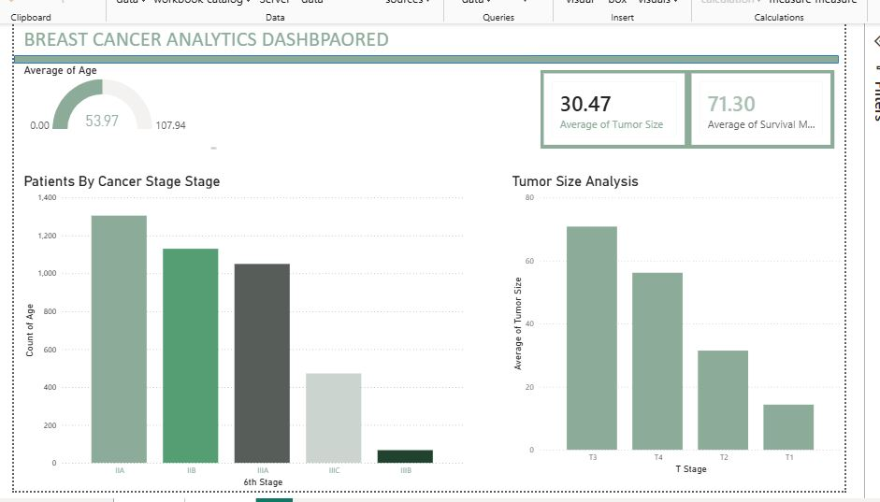

Slide 14
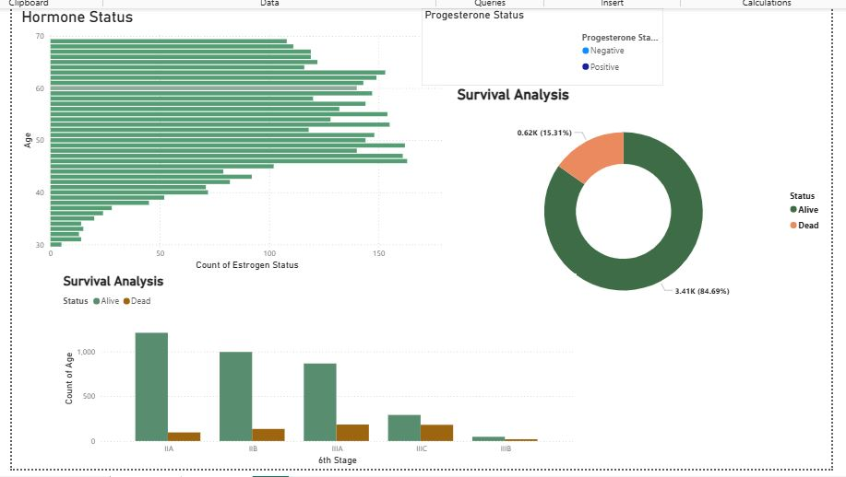

Slide 15
THANK YOU

